Slide 1
Task 2 annotations of the solution

Slide 2
Website run through

Slide 3
Functionality

Slide 4
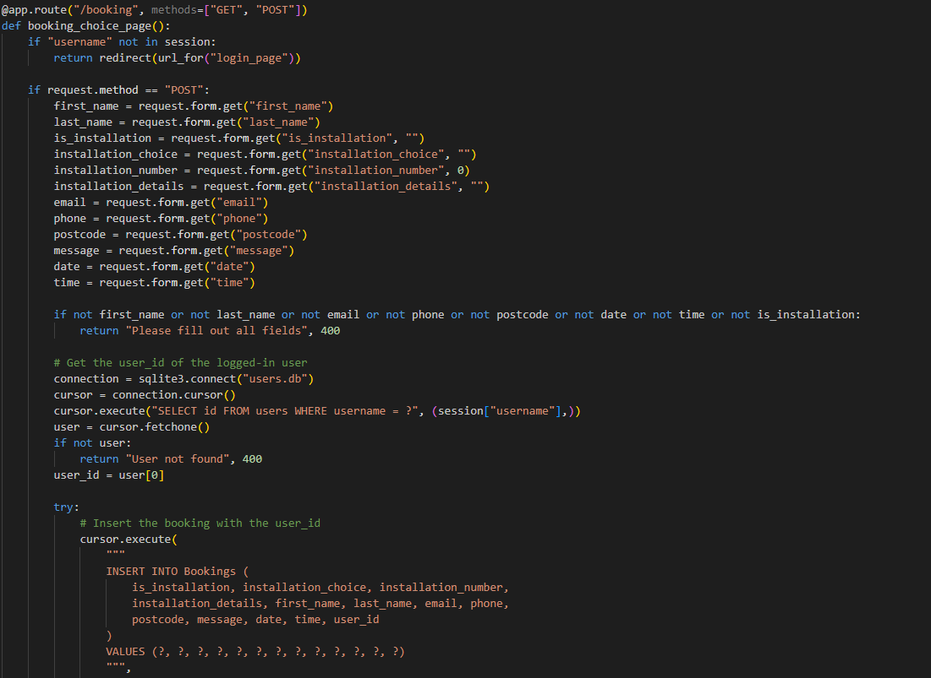
Functionality- languages
Use of more than 1 coding language:
Used python for the backend data handling of the systems and SQLite 3 for creation of the database (example to the right)

Slide 5
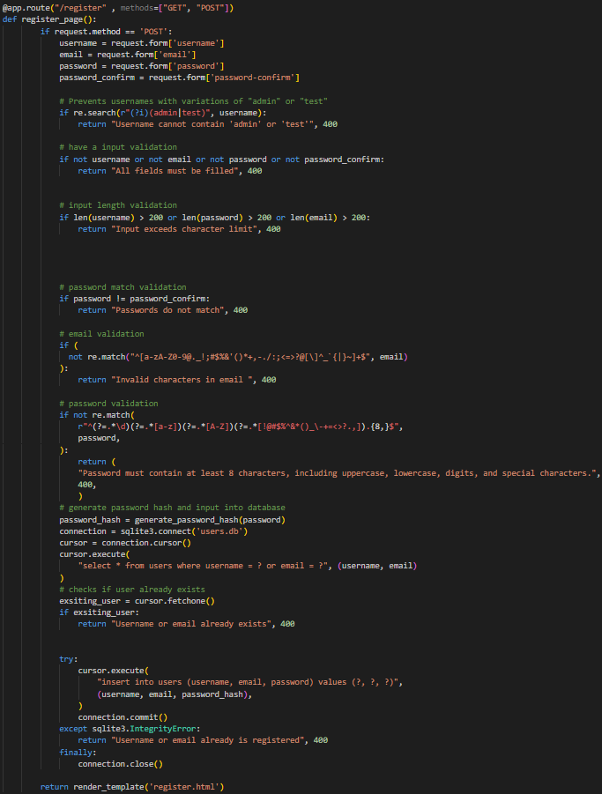
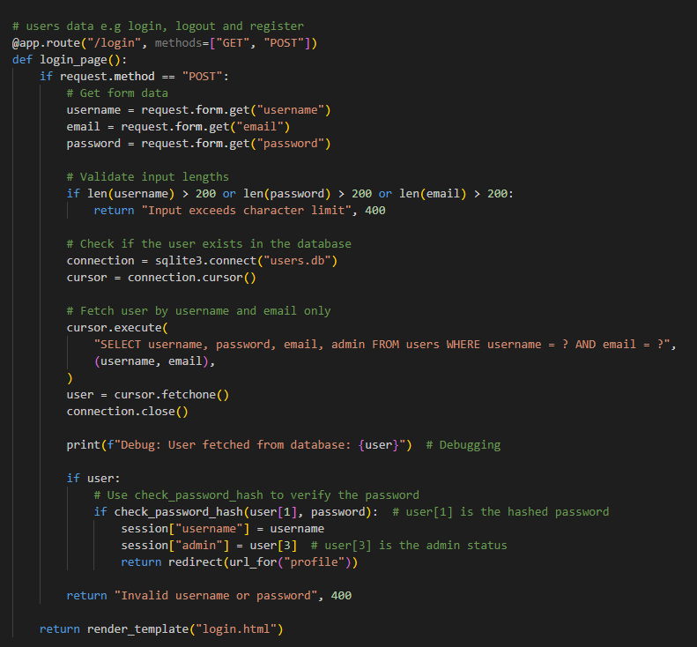
Functionality- user accounts
A functional user account creation and login system:
Implemented a system for users to enter details into a html form that is sent to a backend that encrypts and saves the user newly created account
Created a system that was able to allow users to log into the accounts using python
(code snippets on the next slide with annotation)

Slide 6
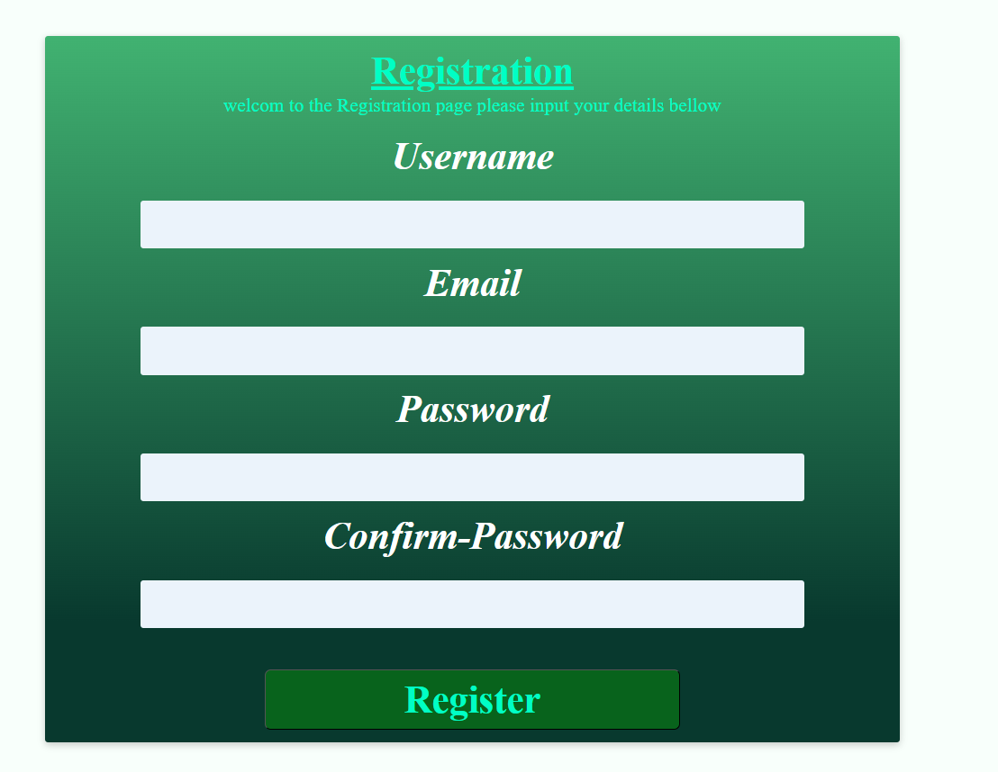
Registration
After the user sends in their data from the front end (on the left) the data is sent the /register function(seen on the right ) which first checks the presence and validity of the inputted data.
After the validation of the user's data is confirmed the user’s password is hashed by the werkzeug.security library into 220-character hash to protect the users data, after that a connection to the database is made in which the function checks that the users inputed username and email don’t match a pre-existing one.
If that check is past then the users details are sent to the database, a final check makes sure that the information has been sent correctly and then the users are redirected back to the home page

Slide 7

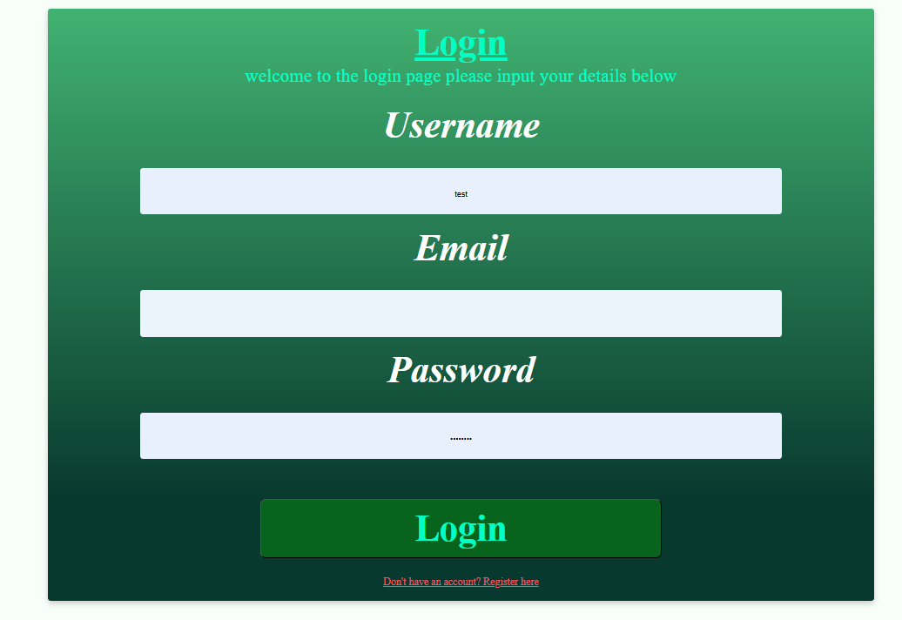
Login
When the user inputs their account information in their data is sent form the front end (on the left) to the /login function(seen on the right ) which first checks the presence and validity of the inputted data.
After the validation of the user's data a connection is made to the database in which the function checks that the users inputted details match a pre-existing one in the database.
For debugging purposes, I had implemented a debug message that sends in the terminal that fetches the username for who just tried to login to make sure that the communication was successful.
Then there is a check against the data in the database against the users' inputted details, if they pass this final check the user Is redirected to their profile.

Slide 8
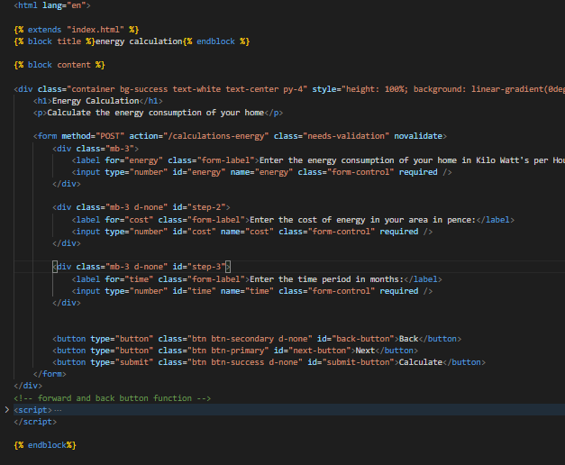
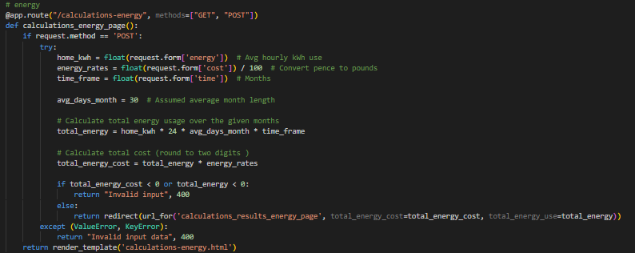
Functionality- organised code
Neatly organised code: separated Back-end and front-end logic for clarity.(shown on the right)

Slide 9
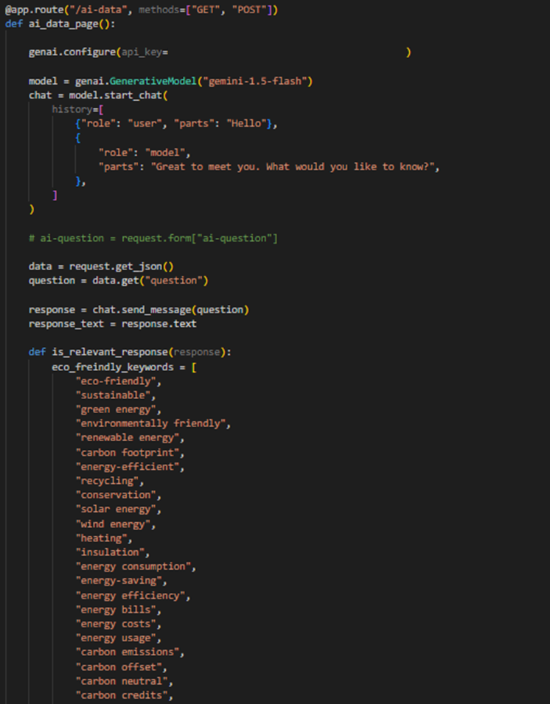
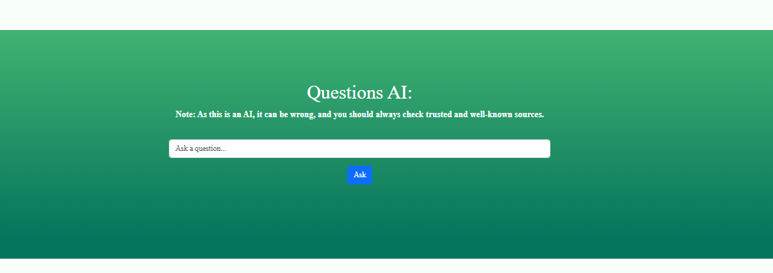
Functionality- Comprehensive APIs
Gemini chatbot Api:
Used googles Gemini chatbot to answer any questions that a user may have on eco –friendly practices or information

Slide 10
Functionality- Interconnected modules
Validation of inputs:
inputs on all pages is validated on both the front and backend to make sure that data is inputted correctly

Slide 11
Functionality- Interconnected modules
Normalised data : the Database are separated by their needs ( users and bookings,) to avoid data redundancy and make readability better.

Slide 12
Code Organisation

Slide 13
Clear indentation and structure
Consistent use of indentation across all files for functions

Slide 14
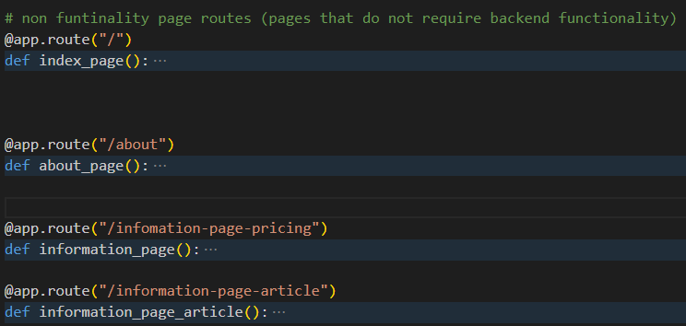
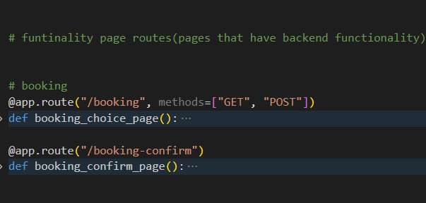
Efficient use of variables/constants and functions/classes
Each core feature is organised and named into a individual class and whether they are functional or nonfunctional ( example on the right) and kept the use of global variables to a minimum and of information that doesn’t pose a high security risk.

Slide 15
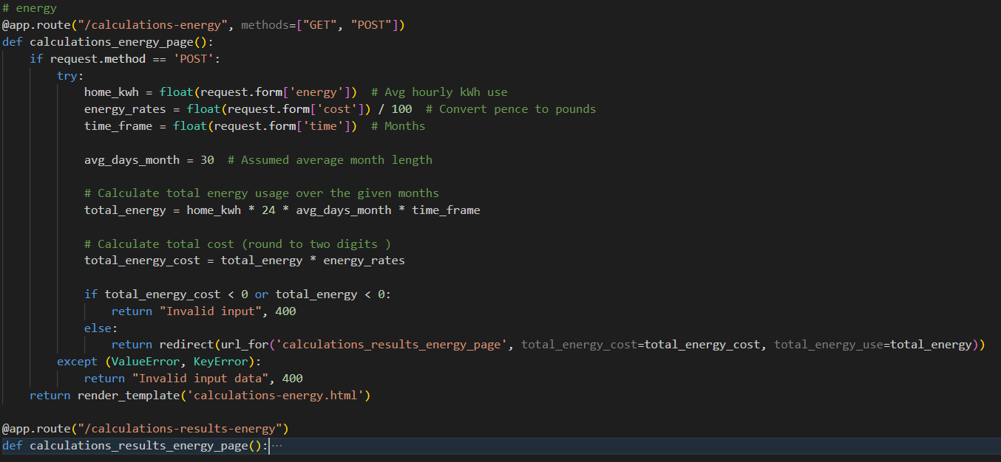
Organisation- comments
All the code is documented with comments for functions and includes any docstring and inline comments where needed to further explain.

Slide 16
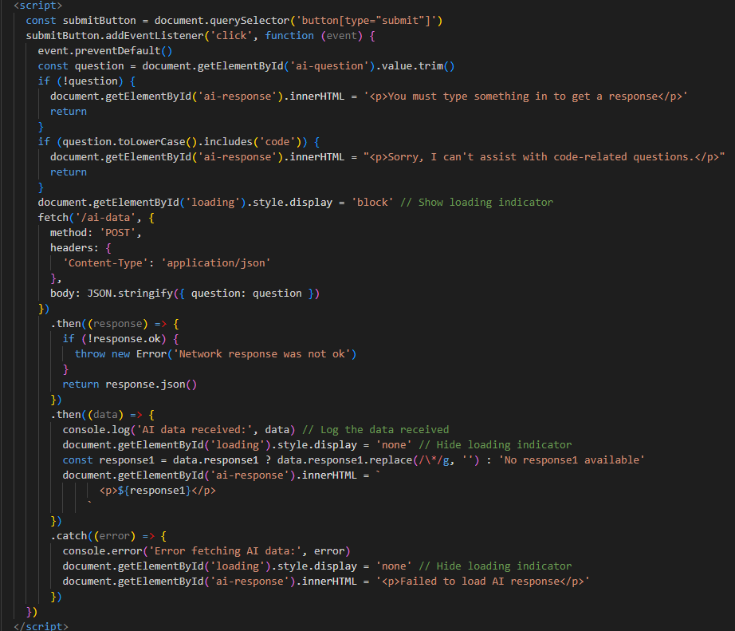
Recursive algorithms with stopping conditions
Systems that need to be kept uptodat will only check for changes once a user interacts sopping constant checks

Slide 17
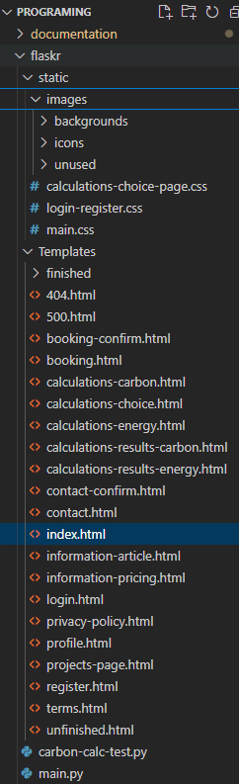
Organisation of files placment and naming
Each core feature is organised and named into a individual class and whether they are functional or nonfunctional ( example on the right)

Slide 18
Testing
Criteria | How its been met
Normal data | Tested all the forms with realistic inputs (e.g booking inputs : 29/03/2025 10:35, ben, smith, test@gmail.com 11778,123, .hello , tick box )
Erroneous data | Tested all forms with empty inputs, incorrect formats, and HTML injections to ensure security.
Extreme data | Used edge cases like year 9999 and number or installations 11 to test robustness
Use of Testing to Inform Iterative Development
Testing of inputs | Did testing of form field validations on desktop and mobile to confirm consistency across platforms
Testing of calculations | Cross-checked calculation outputs against manual calculations to ensure accuracy of information
Testing of validation | Ensured fields rejected malformed or malicious input
Testing of processes | Tested logging in, submitting the various forms, viewed the information pages and logged out repeatedly to ensure stability.
Quality of Iterative Development Process
Records of changes | Documentation of each stage of the prototype's updates in a version log with reasons and dates
Versioning method used | Used Git with commit messages and tags for each major change to the prototype

Slide 19
Legal and Regulatory Guidelines
Criteria | How its been met
Legal compliance (e.g. GDPR) | User data is encrypted, stored securely, and users can delete their data
Ethical considerations | Only the essential data is collected about the user and users have to opt in to allow for data collection
Logically selected fonts and colours | Used Source Serif Pro and high contrast colours used
Privacy and data policy | Dedicated privacy policy explains what data is collected and why.
License and intellectual property | All third-party libraries used have MIT or permissive licences
Terms and conditions | Custom terms and conditions written with plain English explanations.
Multi-platform support | Solution scales and adapts to desktop, tablet, and mobile
Non-discriminatory design | Language and visuals reflect diversity and inclusivity
Efficient fallback cod | Html has all the basic needs if users lack javascript

